Slide 1



Molybdenum isotope evidence for mild oxygenation 2.7 billion years ago
Chadlin M. Ostrander, *Moutusi Roy, Gwyneth W. Gordon, Stephen J. Romaniello and Ariel Anbar
School of Earth and Space Exploration, Arizona State University
*now at MIT
The Arizona Space Grant Undergraduate Research Symposium
April 16th, 2016

Slide 2
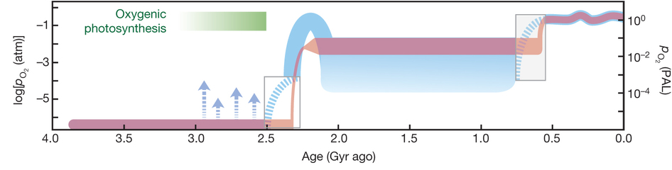
Problem: The timing of the first appearance of oxygen in the Earth’s surface environment is still ambiguous
Lyons, Reinhard and Planavsky, 2014
Solution: Development and application of paleoredox proxies

Slide 3
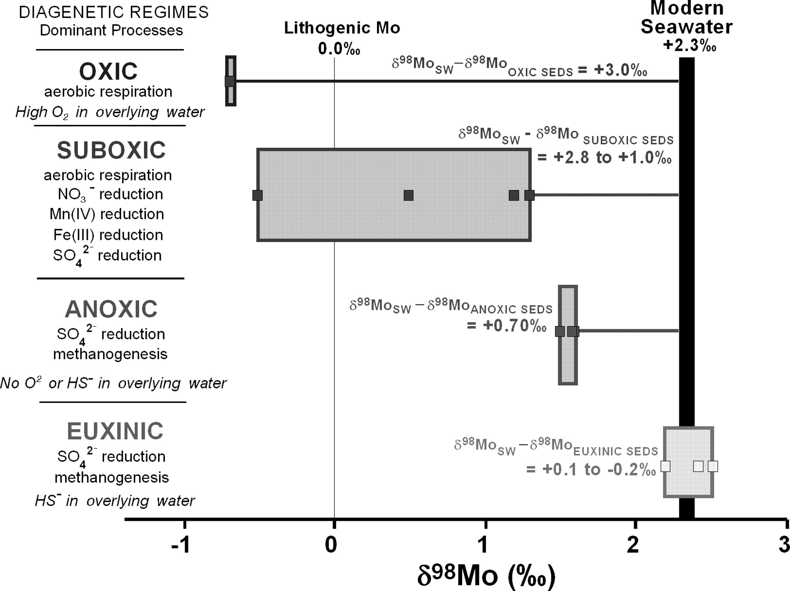

Molybdenum
isotopes
Mo is mobilized by oxidative weathering of continental sulfides
In oxygenated waters, molybdate (MoO₄²⁻) has very long residence time of 800,000 years
In euxinic waters (anoxic and high in H₂S), molybdenum is readily removed from solution
Poulson et al., 2006
$$δ^{98}Mo=\left(\frac{{}_{}^{{98}/{95}}{{Mo}_{sample}−{}_{}^{{98}/{95}}{{Mo}_{std}}}}{{}_{}^{{98}/{95}}{{Mo}_{std}}}\right)×{10}^{3}$$

Slide 4
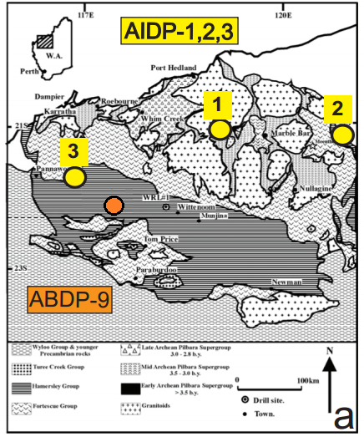
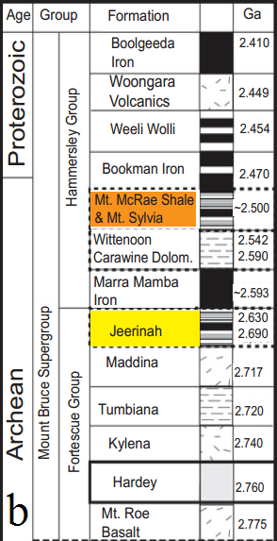
Previous studies
Samples: West Australia, Hamersley Basin
This study

Slide 5
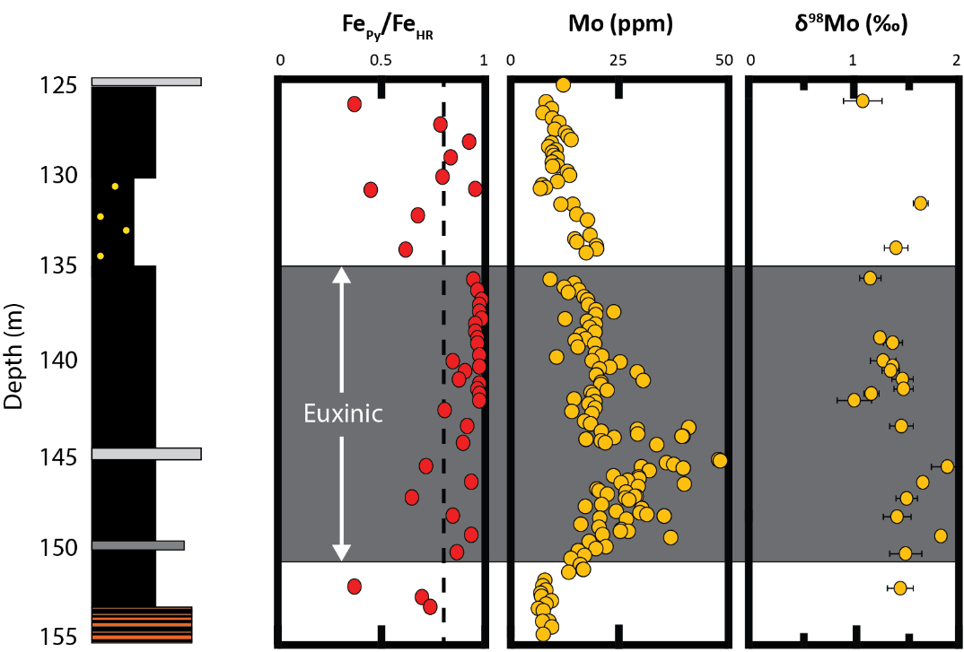
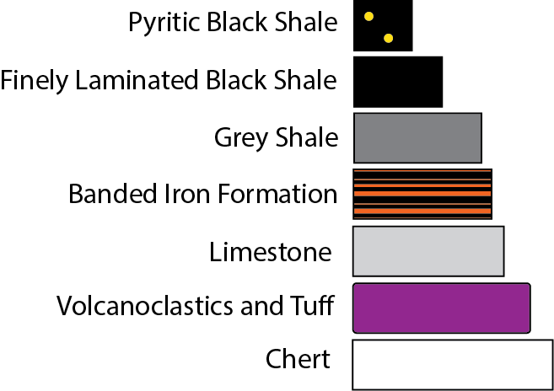
~2.5 Ga
Previous studies:
Anbar et al. (2007) and Duan et al. (2010)
Molybdenum enrichments in Mt. McRae Shale
(up to 50ppm)
δ⁹⁸Mo approaching 2‰ (very heavy!)

Slide 6
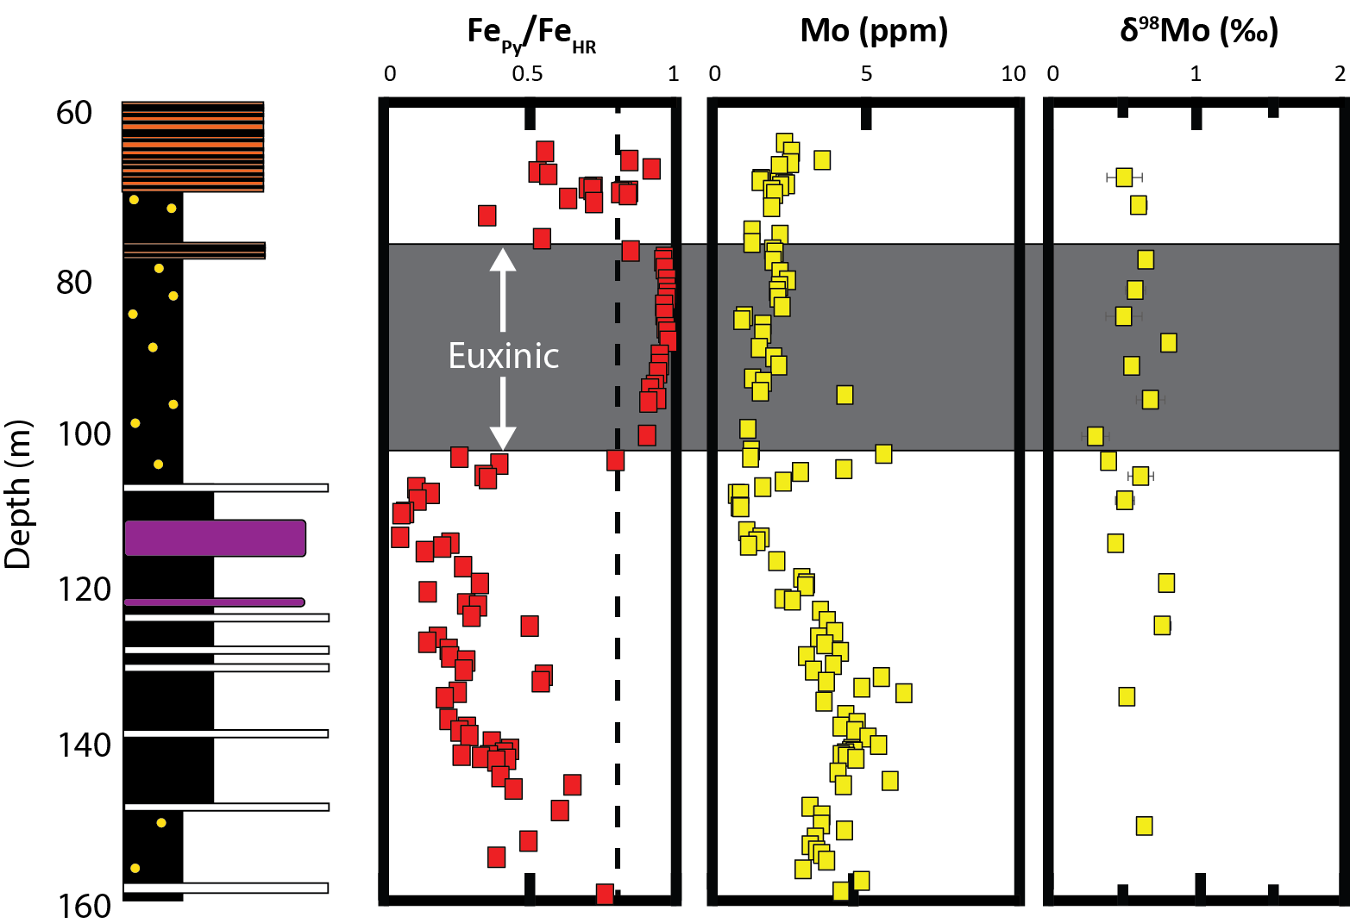
~2.6 Ga
This study:
AIDP-3 (off-shore)
Molybdenum enrichments in Roy Hill Shale (up to 7ppm), but not during euxinia
δ⁹⁸Mo as high as 0.83‰

Slide 7
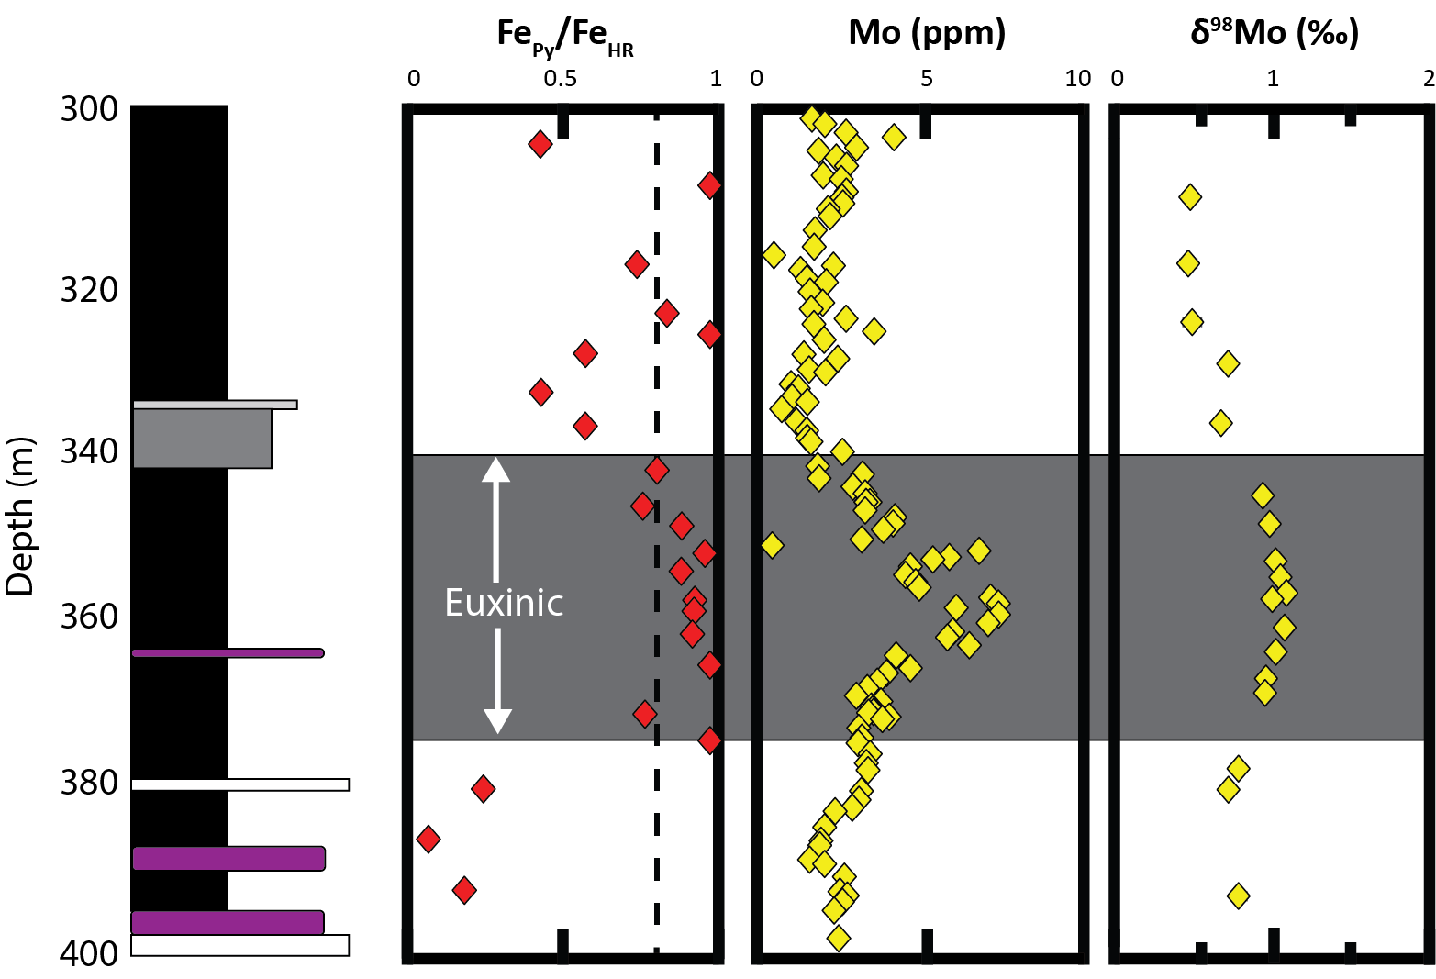
~2.7 Ga
This study:
AIDP-2 (near-shore)
Molybdenum enrichments in Roy Hill Shale (up to 7ppm)
δ⁹⁸Mo as high as 1.06‰

Slide 8
Conclusions
Mo isotope compositions in euxinic shales from both core are heavier than crustal values (0‰).
  AIDP-3 (off-shore): up to 0.83‰
  AIDP-2 (near-shore): up to 1.06‰
These values, especially those from AIDP-2, are indicative of mild oxygenation ~2.7 billion years ago.
  Acknowledgements
  We thank ASU NASA Space Grant, Agouron Institute, and the National Science Foundation for supporting AIDP as well as members from Anbarlab for their assistance in all stages of this process.

Slide 9
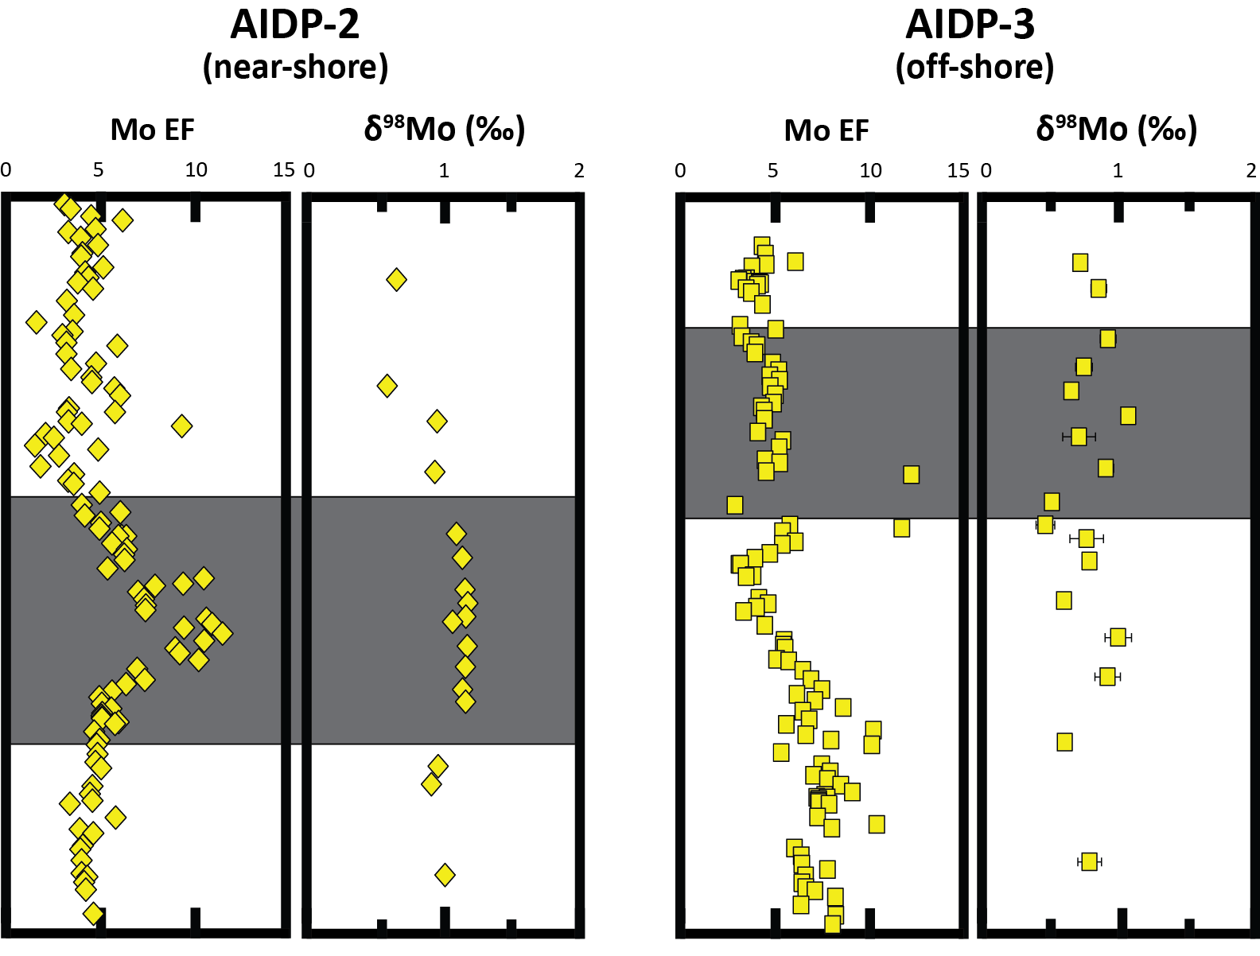
Detrital Corrections (backup slide)
Normalized to Al

Slide 10
Detrital Corrections (backup slide)
Normalized to Al

